Slide 1

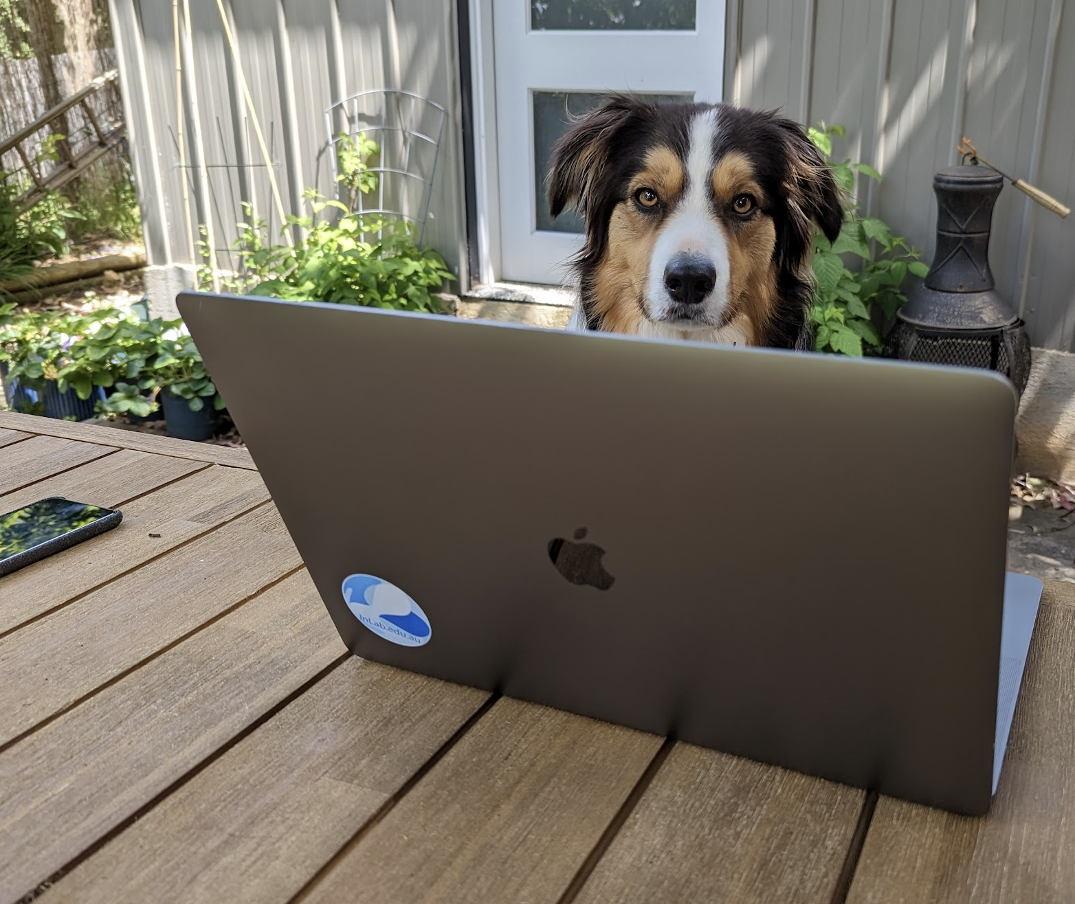
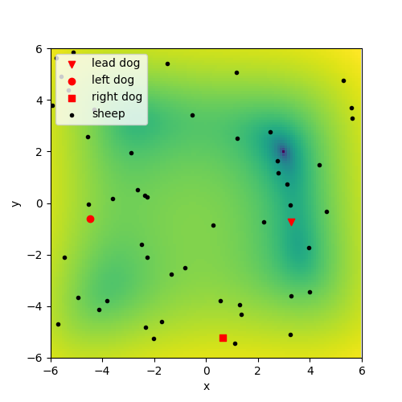

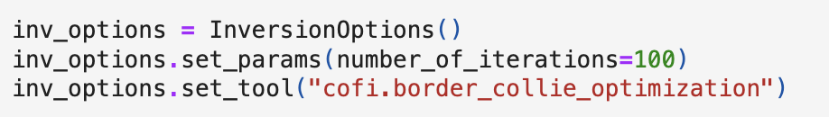
But what about my favourite metaheuristic optimiser?
Border Collie Optimization
Global minimum
www.inlab.au
Notes:
Horizon 1 – Overcomplete tomography represents a Horizon 1 concept in that it could in 3 years become part of established inversions method

Slide 2


Beyond the workshop
A key aspect of CoFI is the flexibility provided for exploration and experimentation in inversion
Created examples and brought existing capabilities together
Making unique approaches accessible through the common interface and grow the set of examples
A FAIR example driven framework…
A conversation about CoFI over coffee is just the beginning…
www.inlab.au
Explore our examples
Setup your own inverse problem
Let us know what you think
Notes:
Horizon 1 – Overcomplete tomography represents a Horizon 1 concept in that it could in 3 years become part of established inversions method

Slide 3
Wrap up
This is an open source project
Feedback:
Choosing priorities: Expanding the methods; the examples, building a community;
Wishlist includes: scalability (HPC); new examples; automatic differentiation, Surrogate modelling. Link to new optimization and sampling packages…
Work with us & get involved:
creating an application example using CoFI
join our slack community: raise an issue on github:
http://inlab.au/community https://github.com/inlab-geo/cofi/issues
Notes:
Horizon 1 – Overcomplete tomography represents a Horizon 1 concept in that it could in 3 years become part of established inversions method

Slide 4
Wrap up
Notes:
Horizon 1 – Overcomplete tomography represents a Horizon 1 concept in that it could in 3 years become part of established inversions method

